Slide 1

Best location for new Coffee Shop - Chicago
Juan Belaustegui
Feb. 2020

Slide 2

Choosing location for a new store is challenging
Select new location is not easy. There are a lot of variables to analyze.
We can have an idea from someone who knows the city to cover, but it is posible that you don’t have a complete visión .
A data Analysis with georeference can help a lot to make a decisión.

Slide 3
Data acquisition and cleaning
This study is to provide a recommendation for a new Coffee shop in Chicago.
The data of neighborhoods has been gathered from Wikipedia https://en.wikipedia.org/wiki/List_of_neighborhoods_in_Chicago
Population information from last census www.chicago.gov/content/dam/city/depts/zlup/Zoning_Main_Page/Publications/Census_2010_Community_Area_Profiles/Census_2010_and_2000_CA_Populations.pdf
Total of 4,282 venues and 343 categories were processed in the raw dataset.
Cleaned data consisted in 31 rows with 10 most common venues plus coordinates and population.

Slide 4
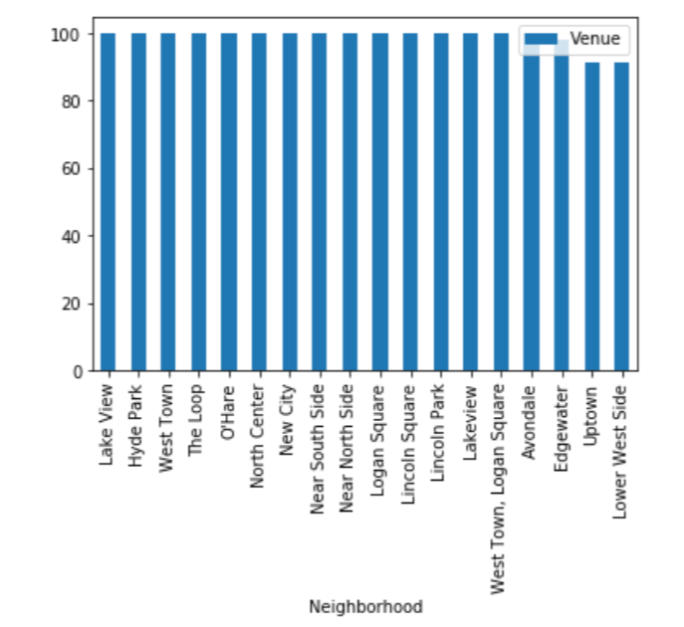
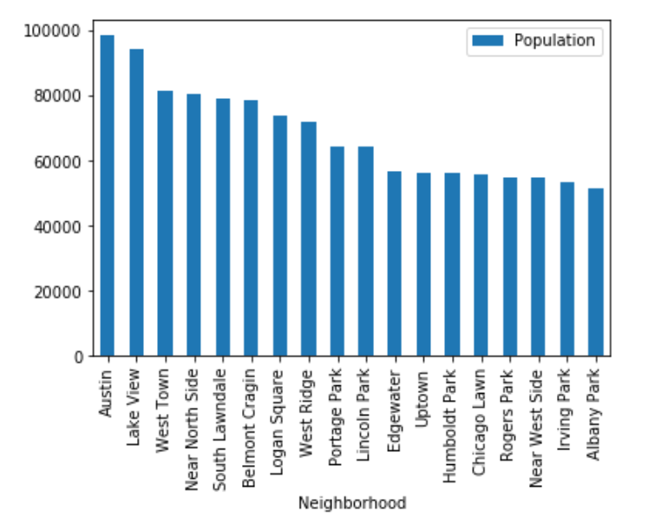
Data Neighborhood Analysis

Slide 5
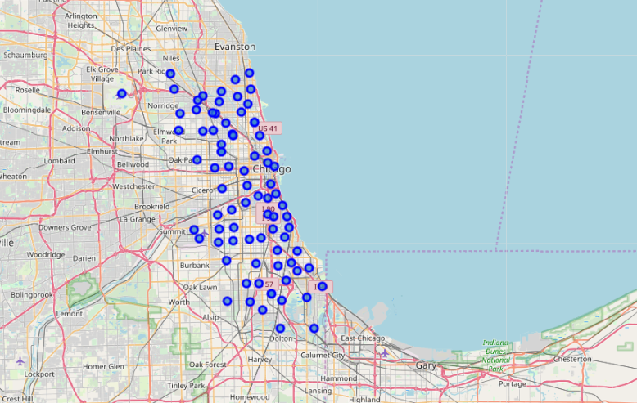
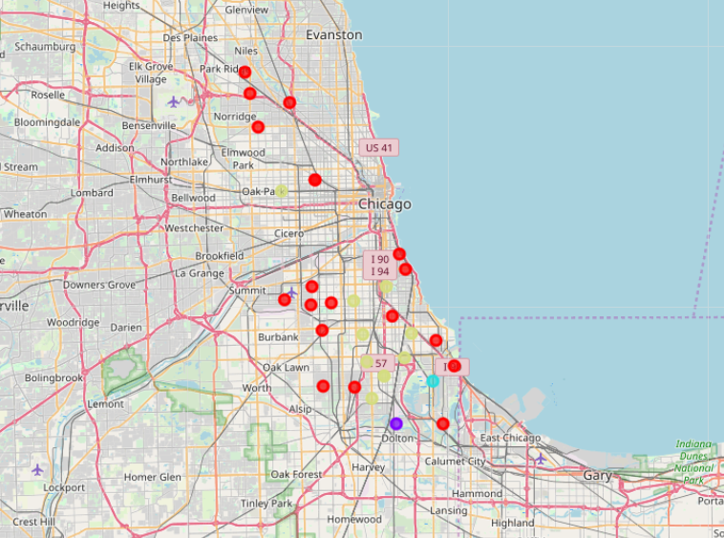
Chicago Neighborhoods fr om Chicago
Total Neighborhoods
Neighborhoods with No Coffee Store presence.

Slide 6
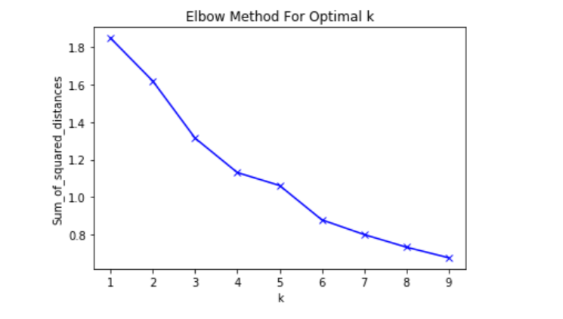
Clustering Neighborhoods________________
Determining K optimum
K=4 Plotting clusters

Slide 7
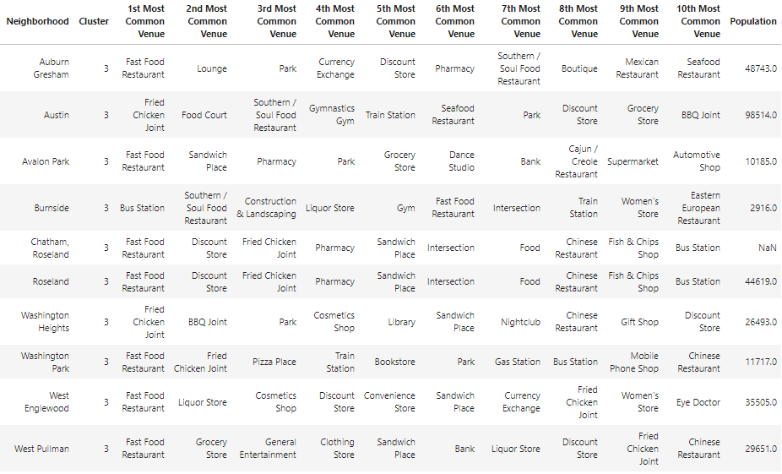
Cluster 3 detail of Austin Neighborhood

Slide 8
Conclusion and Recommendations
This study analyzed the best option where to open a new Coffee Shop in Chicago.
With the information gathered from open sources, like Wikipedia and Foursquare API, we conclude the best option is in Austin Neighborhood.
This study can be replicated to do the same with any kind of store in any place around the world.
For a more detailed information, the data should be crossed with a survey on the field, specially in Austin, where the recommendation is provided.

